Slide 1

MEC136: ENGINEERING GRAPHICS AND DIGITAL FABRICATION

Slide 2
Course Outcomes (CO)
CO1: understand the fundamentals of engineering drawing including usages of drawing tools, line- types, dimensioning, letter-writing, scales and AutoCAD software.
CO2: recognize the conceptual framework of orthographic projections of points, lines and basic commands of AutoCAD software.
CO3: apply the knowledge to draw the orthographic and sectional views and to create 2D drawings on AutoCAD software.
CO4: acquaint the techniques to develop the isometric views and surfaces of common geometries and to create 3D models on AutoCAD.
CO5: impart the conceptual understanding of digital fabrication and rapid prototyping techniques.
CO6 : learn and discuss the varied important aspects of several rapid prototyping systems.

Slide 3
Program Outcomes (PO)
PO1: Engineering Knowledge:: Apply the knowledge of mathematics, science, engineering fundamentals, and an engineering specialization to the solution of complex engineering problems.
PO2: Problem Analysis:: Identify, formulate, research literature, and analyze complex engineering problems reaching substantiated conclusions using first principles of mathematics, natural sciences, and engineering sciences.
PO3: Design/development of solutions:: Design solutions for complex engineering problems and design system components or processes that meet the specified needs with appropriate consideration for the public health and safety, and the cultural, societal, and environmental considerations.
PO4: Conduct investigations of complex problems:: Use research-based knowledge and research methods including design of experiments, analysis and interpretation of data, and synthesis of the information to provide valid conclusions.
PO5: Modern tool usage:: Create, select, and apply appropriate techniques, resources, and modern engineering and IT tools including prediction and modeling to complex engineering activities with an understanding of the limitations.
PO6: The engineer and society:: Apply reasoning informed by the contextual knowledge to assess societal, health, safety, legal and cultural issues and the consequent responsibilities relevant to the professional engineering practice.

Slide 4
Program Outcomes (PO)
PO7: Environment and sustainability:: Understand the impact of the professional engineering solutions in societal and environmental contexts, and demonstrate the knowledge of, and need for sustainable development.
PO8: Ethics:: Apply ethical principles and commit to professional ethics and responsibilities and norms of the engineering practice.
PO9: Individual and team work:: Function effectively as an individual, and as a member or leader in diverse teams, and in multidisciplinary settings.
PO10: Communication:: Communicate effectively on complex engineering activities with the engineering community and with society at large, such as, being able to comprehend and write effective reports and design documentation, make effective presentations, and give and receive clear instructions.
PO11: Project management and finance:: Demonstrate knowledge and understanding of the engineering, management principles and apply the same to one’s own work, as a member or a leader in a team, manage projects efficiently in respective disciplines and multidisciplinary environments after consideration of economic and financial factors.
PO12: Life-long learning:: Recognize the need for, and have the preparation and ability to engage in independent and life-long learning in the broadest context of technological change.
PO13: Competitive Skills:: Ability to compete in national and international technical events and building the competitive spirit along with having a good digital footprint.

Slide 5
Program Specific Outcomes (PSO)
PSO1: Apply basic knowledge in the areas such as Software Engineering, Networking amp Security, Database Management Systems, Intelligent Systems, Operating Systems, and System Architecture for building Software products.
PSO2: Attain the ability to design and develop software based systems, evaluate and recognize potential risks and provide creative, economical and optimal solutions.
PSO3: Provide effective and efficient real time solutions using attained knowledge in inter-disciplinary domains for societal benefits through projects.
PSO4: Ability to adapt future technologies through acquired skills and knowledge to ideate, design, test and deploy solutions for different business environments.

Slide 6
Open Educational Resources
Unit | Broad topic/Sub Topic | OER Type | Title of OER | *%age unit mapped with OER (approx) | Source URL
Unit 1 | Introduction to Engineering Drawing | MOOC | Engineering Drawing And Computer Graphics | 100 | Engineering Drawing and Computer Graphics - Course (nptel.ac.in)
Unit 2 | Projection of Points and Lines | MOOC | Engineering Drawing And Computer Graphics | 100 | Engineering Drawing and Computer Graphics - Course (nptel.ac.in)
Unit 3 | Orthographic and Sectional Views | MOOC | Engineering Drawing And Computer Graphics | 100 | Engineering Drawing and Computer Graphics - Course (nptel.ac.in)
Unit 4 | Isometric Views and Development of Surfaces | MOOC | Engineering Drawing And Computer Graphics | 100 | Engineering Drawing and Computer Graphics - Course (nptel.ac.in)
Unit 5 | Introduction to Digital Fabrication | MOOC | Digital Manufacturing, 3D Printing | 100 | NPTEL :: Mechanical Engineering – Product Design and Manufacturing (nptel.ac.in)
Unit 6 | Rapid Prototyping Systems | MOOC | Digital Manufacturing, 3D Printing | 100 | NPTEL :: Mechanical Engineering – Product Design and Manufacturing (nptel.ac.in)

Slide 7
Text Books and References
Text Books:
  Engineering Drawing with an Introduction to AutoCAD, Dhananjay A. Jolhe, McGraw Hill Education.
  Rapid Prototyping- Principles and Applications (2nd edition), Chua, C.K., Leong, K.F., Lim, C.K., World Scientific Publications, London.
Reference Books:
  Engineering Graphics, K C John, Prentice Hall.
  Engineering Drawing, N.D. Bhat & M. Panchal, Charotar Publishing House Pvt. Ltd.
  Manufacturing Engineering and Technology, Serope Kalpakjian, Steven R. Schmid, Pearson

Slide 8
Course Details
Credits 4
L:T:P 2:2:0
(2 lectures and 2 tutorials per week)
Exam Category: 55
(All subjective)
CA Category: C010203
(Total 4 tasks, 1 compulsory and out of remaining 2 best out of 3 to be considered)

Slide 9
Course Assessment Model
Marks break up*
Attendance 5
CA (C010203) 30
MTE 25
ETE 40
Total 100

Slide 10
Course Content
Before MTE
Unit- I | Introduction to Engineering Drawing : Conceptual framework of drawing instruments, line types, dimensioning, single stroke vertical gothic letter writing, scales-plain and diagonal, introduction to AutoCAD interface- units, limits, navigation, OSNAP, ortho, and UCS
Unit- II | Projection of Points and Lines : Introduction, principles of orthographic projections, orthographic projection of points and lines, concept of traces, AutoCAD commands- line, circle, arc, polyline, move, copy, trim, text, and dimensioning style, hands-on-practice on AutoCAD
Unit- III | Orthographic and Sectional Views : Introduction, principles, importance, orthographic and sectional (full, half, and offset) views in both first and third angle projections systems, practice, AutoCAD commands- line type and its properties, rectangle, polygon, ellipse, hatch, scale, fillet, chamfer, array, erase, explode, offset, and extend, hands-on-practice on 2D drawings

Slide 11
Course Content
After MTE
Unit- IV | Isometric Views and Development of Surfaces : Introduction, terminology, isometric scale, isometric views of prisms and pyramids, dimensioning, importance of surface development, development methods, surface development of cylinder, prisms, cone and pyramids, AutoCAD commands for 3D- 3P UCS rotation, standard shapes, extrude, revolve, presspull, subtract, union, orbit, and visual styles, hands-on-practice on 3D drawings
Unit- V | Introduction to Digital Fabrication : Introduction, needs of digital manufacturing, prototype- types and roles, rapid prototyping (RPT)-fundamentals, phases, classification, process chain- modelling-data conversion-checking-building-postprocessing, advantages, conversion of 3D model to STL file, handson-practice on 2D and 3D drawings
Unit- VI | Rapid Prototyping Systems : Liquid-based SLA- introduction, specifications, apparatus, process, photopolymers, photopolymerization, layering, applications, solid-based LOM- introduction, processpreprocessing-building-postprocessing, materials, principle, advantages, disadvantages, applications (RPT), powder-based SLS- process, SLS materials, principle (SLS), advantages (SLS), disadvantages (SLS), applications (SLS)

Slide 12
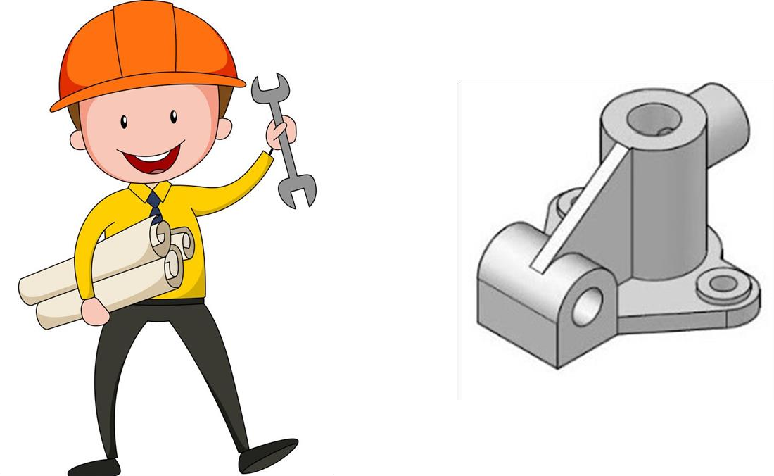
Introduction to Engineering Drawing

Slide 13
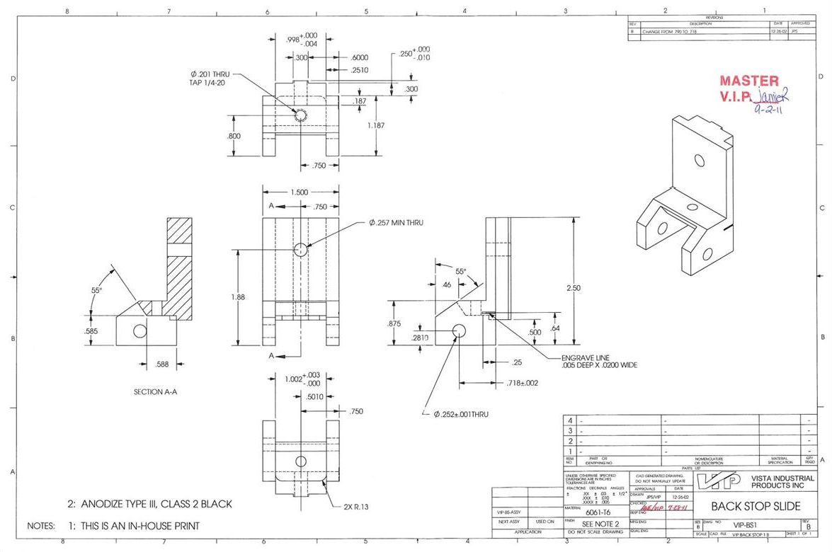
Introduction to Engineering Drawing

Slide 14
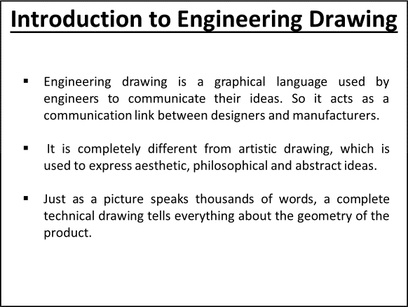

Slide 15
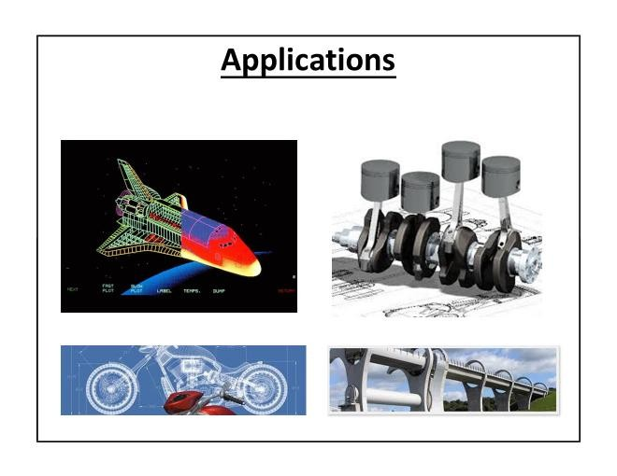

Slide 16

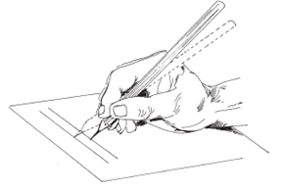
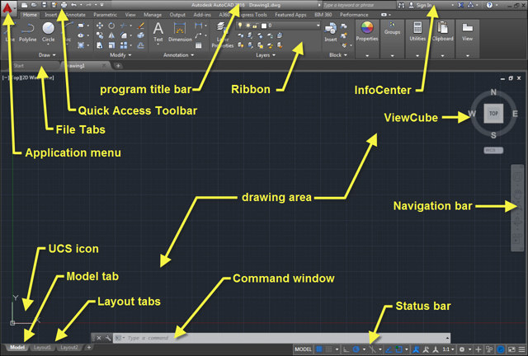
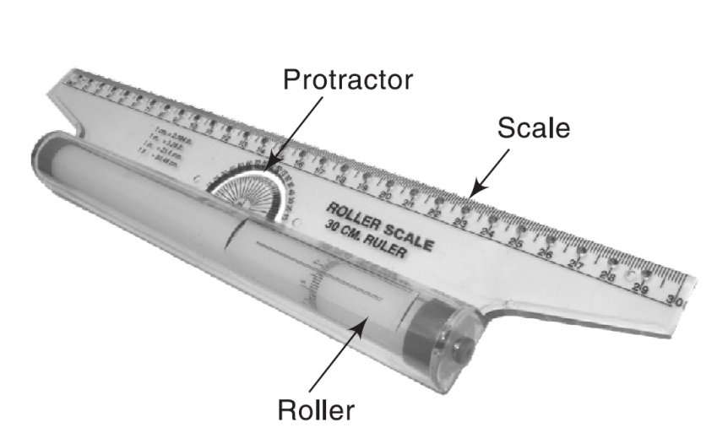
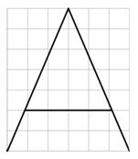

Unit 1: Introduction to Engineering Drawing
Conceptual framework of drawing instruments
Line types, dimensioning
Single stroke vertical gothic letter writing,
Scales-plain and diagonal,
Introduction to AutoCAD interface

Slide 17
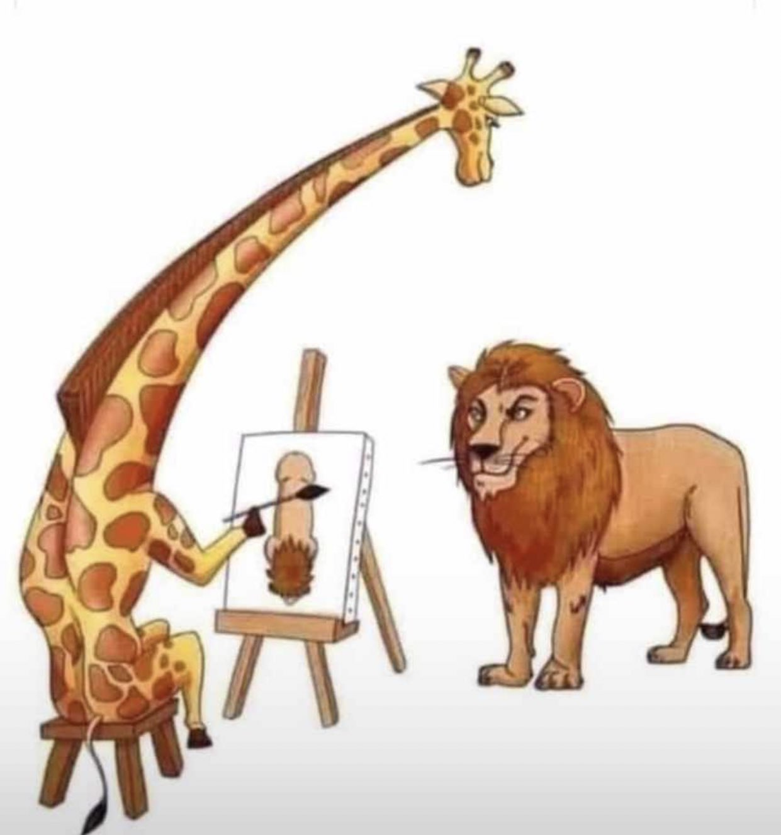
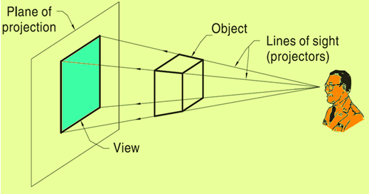
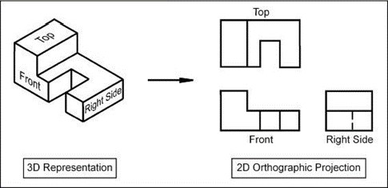
Unit 2: Projection of Points and Lines
Principles of orthographic projections
Projection of points and lines
AutoCAD- basic commands

Slide 18
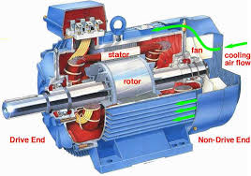
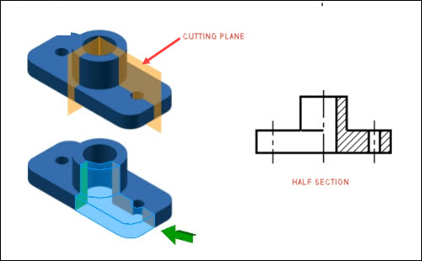
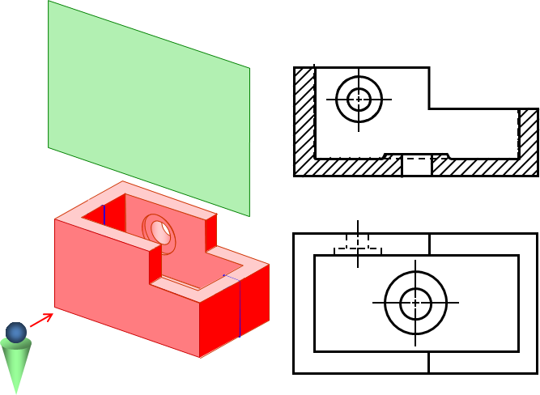
Unit 3: Orthographic and Sectional Views
Introduction, principles, importance, orthographic views
Sectional views (full, half, and offset)
AutoCAD commands for 2D

Slide 19
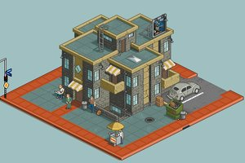
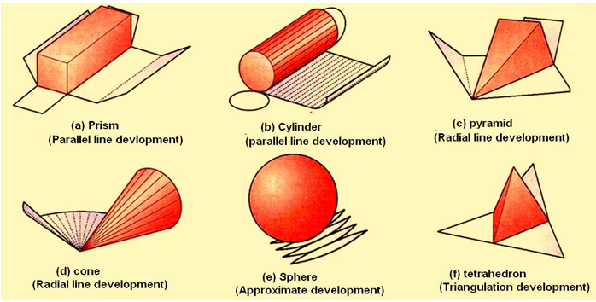
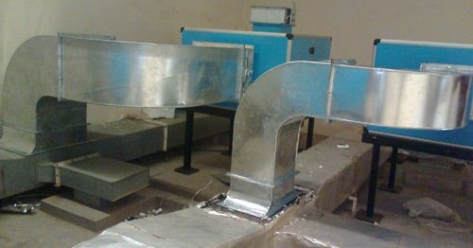
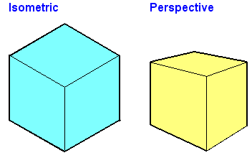
Unit 4: Isometric Views and Development of Surfaces
Introduction isometric projection, terminology
Isometric scale, isometric views of prisms and pyramids
Introduction to surface development
Surface development of cylinder, prisms, cone and pyramids
3D modelling on AutoCAD

Slide 20
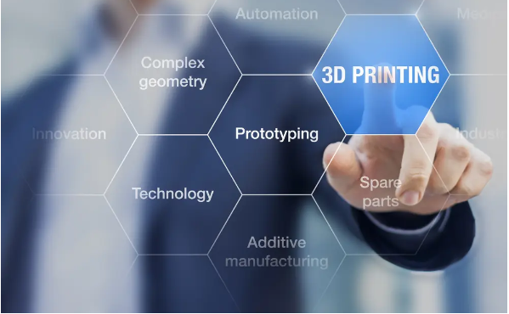
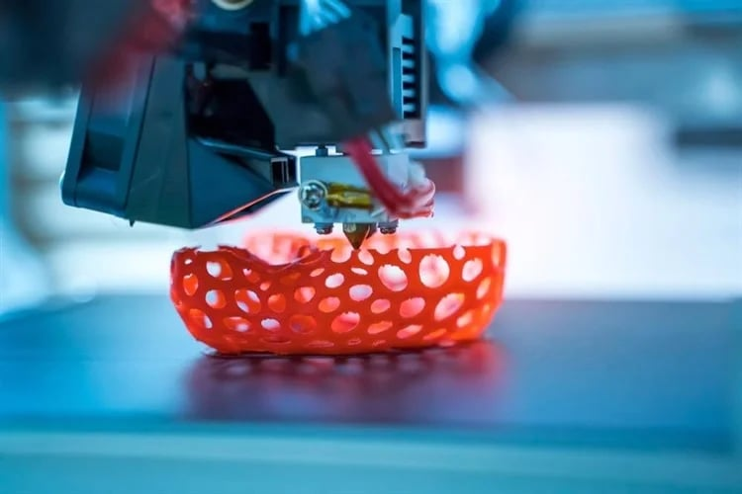
Unit 5: Introduction to Digital Fabrication
Need of digital manufacturing
Prototype, types and roles of prototypes
Rapid Prototyping (RPT), phases of RPT, fundamentals of RPT, advantages,
Practice of 2D and 3D modelling on AutoCAD

Slide 21
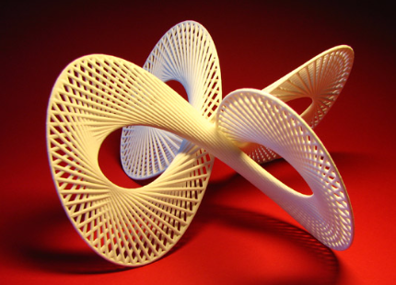

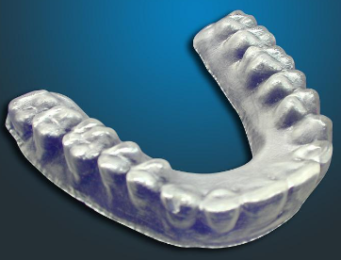
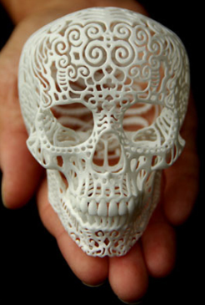
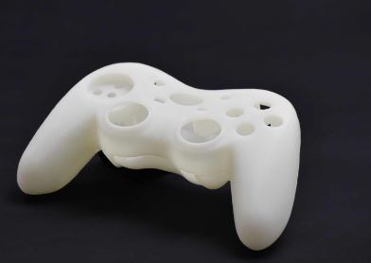
Unit 6: Rapid Prototyping Systems
Classification of RPT systems,
Process chain,
3D modelling,
Data conversion,
Checking-building-postprocessing,
Stereolithography (STL)-process, principle

Slide 22
Benefits of Engineering Drawing in CSE
Every engineer should have the ability to express their own design ideas as a drawing and convey to others so that it can be manufactured,
Technical drawing allows efficient communication among engineers and can be kept as a record of the planning process,
CPU design can only be done through the basics of engineering drawing,
It helps you to convert 2D in 3D model which is also a very important criteria in game design.

Slide 23
Benefits of Digital Manufacturing in CSE
Rapid Prototyping helps designers present new concepts to board members, clients or investors so that they can understand and approve a development of product,
It helps you test different components and refine your ideas, providing a clear pathway from concept to reality,
Reducing product development costs,
Allowing functionality testing

Slide 24
Benefits of Digital Manufacturing in CSE
Eliminating the risk of product failure,
Improving user involvement,
Increased efficiency through automated exchange of data,
Avoidance of costly errors due to missed or misinterpreted data,
Digital tools allow manufacturers to centralize and manage the entire manufacturing process in one software platform,

Slide 25
THANKS

